Slide 1
Networking Technologies
AICT012-4-2 and Version VE3
Introduction and Overview

Slide 2
Lecturer Information
Noris binti Ismail
Email: noris.ismail@apu.edu.my
School of Technology
Network and Security Forensic Group

Slide 3
Pre-requisites for this module
Nil

Slide 4
Aims of this module
Provide an insight into the basic concepts of data communications
Provide an understanding of networking, both Local and Wide Area Networks
Introduce students to standards and protocols used in data communication and networking and, in particular, the basic principles of the ISO-OSI Reference Model

Slide 5
Course Learning Outcomes, (CLOs)
At the end of this module, YOU should be able to:
Explain fundamental principles of networking and network operations relevant to TCP/IP protocols and OSI model architecture (C2,PLO1)
Apply network layer, IP addressing and network security concepts in building and securing a small network (C3, PLO2)
Perform router, switches and end device configurations for enterprise network using simulation tool based on the given scenario. (P3, PLO3)

Slide 6
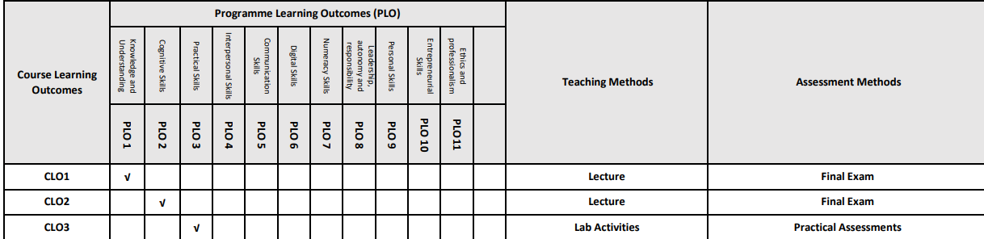
Mapping of CLOs with MOEs Domain
PLO1 – Knowledge and Understanding
PLO2 - Cognitive Skills
PLO3 – Practical Skills

Slide 7
Teaching Strategies
Lecture
Tutorial: Lab Session for Individual Lab Practice/Assessment
Case Study (Individual and Group)
Group Discussion

Slide 8
Assessment Methods
Exam – Exam Week (40%) : CLO1 and CLO2
Practical (60%) : CLO3
Practical Assessment 1 (20%) : Basic End Devices Configuration: Week 7 (Before Mid Semester Break)
Practical Assessment 2 (40%) : Basic End Devices Configuration & Scenario Based Configurations: Week 14
**refer to SAIS for details

Slide 9
Student Learning Time (SLT)
Course Credit Value: 4
Total Learning Hours:
Lecture: 28 hours per semester
Tutorial / Case Study : 28 hours per semester
Independent Learning Time: 83 hours
** Tutorials to be conducted in Labs

Slide 10
Methods of Delivery
Hence,
We are now moving from the traditional topic based teaching to outcome-based education

Slide 11
Outcomes Based Education (OBE)
OBE is education based on producing particular educational outcomes that:
Focus on what students can actually do after they are taught
Expect all learners / students to successfully achieve particular (sometimes minimum) level of knowledge and abilities.

Slide 12
So…What is OBE?
It’s
NOT
What we want to teach,
It’s
What You should learn

Slide 13
Course Content Outline
CLO1 : Final Exam (40% - 30 MCQs), CLO2: Final Exam (60% - 3 Structured Questions) – Total % = 40%
Lecture
Introduction to Networks
Network Protocols and Communications
Network Access
Ethernet
Network Layer
Transport Layer
Application Layer
Tutorial
Data Communication Concepts
OSI Model and TCP/IP model

Slide 14
Course Content Outline
CLO3: Practical Assessment (60%) - 2 practical assessments – 20% and 40%
Tutorial / Case Study / Group Discussion
Configure Network Operating System
IP Addressing
Case Study : Subnetting IP Networks
Build a Small Network
Topology / Transmission Medium / Network Devices
*to be conducted in labs and auditorium

Slide 15
What is expected of you
You should abide to all the rules & regulation of APU
Proper attire
No speaking of dialects
Attendance is compulsory and valid medical certificates or letters from parents /guardians must support any absence from class.
Three lateness will be equal to one absence
All pagers and hand phones should be turned off during lectures.

Slide 16
What support is available for you
Consultation hours
Resources
Reference material
Essential Reading
Wendell Odom, (2019).CCNA 200-301 Official Cert Guide, Volume 1, Published by Cisco Press. Part of the Official Cert Guide series. ISBN-13: 978-0-13-579273-5.
Tim Szigeti, David Zacks, Matthias Falkner, Simone Arena, (2019).Cisco Digital Network Architecture: Intent-based Networking for the Enterprise. Published by Cisco Press. ISBN-13: 978-1-58714-705-0.
Internet resources
- Access to Cisco Networking Academy Platform - CCNA 1.
- Cisco Packet Tracer.

Slide 17
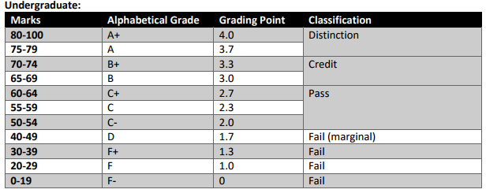
Achievement requirements

Slide 18
Question and answer session
Q & A

Slide 19
What we will cover next
Introduction to Networks

